Slide 1


UIDAI
TEAM:DATA MUGHALS
T.SRAVYA
S.NITHIN
Y.AKHIL
P.SAI KUMAR
K.HRISHIKESH

Slide 2

Agenda
AADHAR UPDATION
Submitting basic details
OTP VERIFICATION
PROVIDING CONSENT FORM
E-KYC OPTION
CHECKING DATA FROM DATA BASE
ADDRESS VERIFICATION
GPS TRACKING

Slide 3

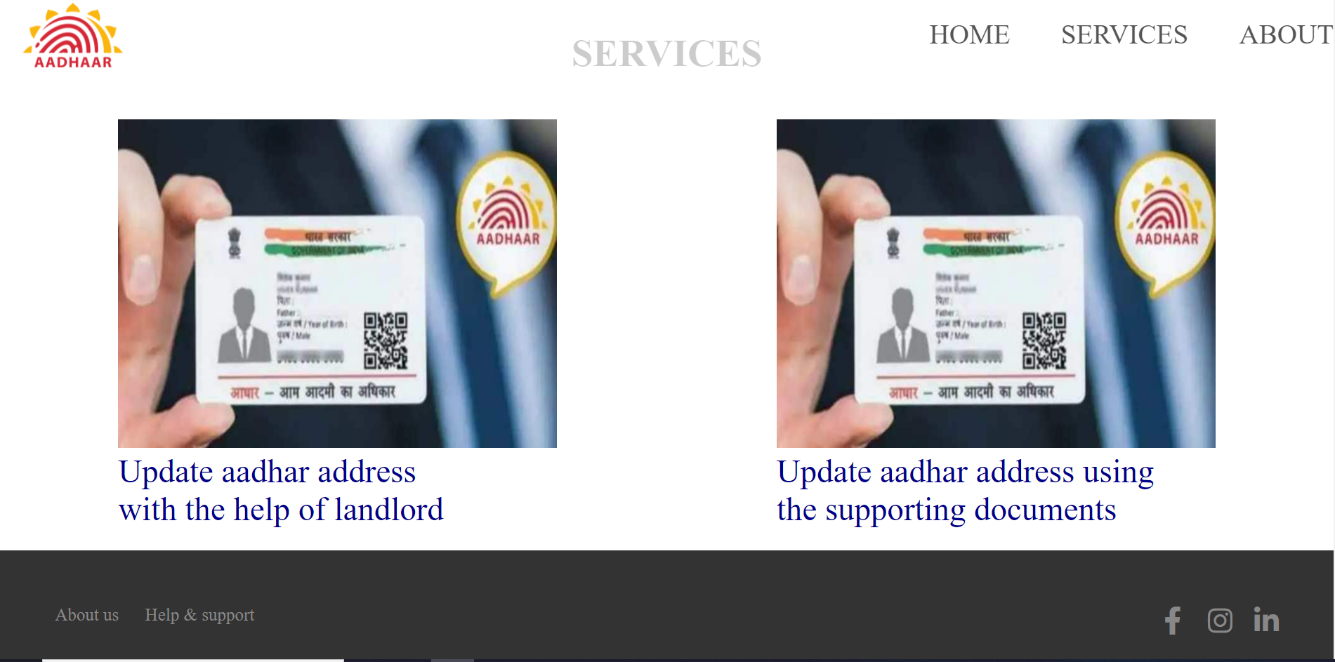
Introduction
Uidai (Aadhar) website is designed to provide option for the users to change their address even if they don’t have any proper proofs.

Slide 4
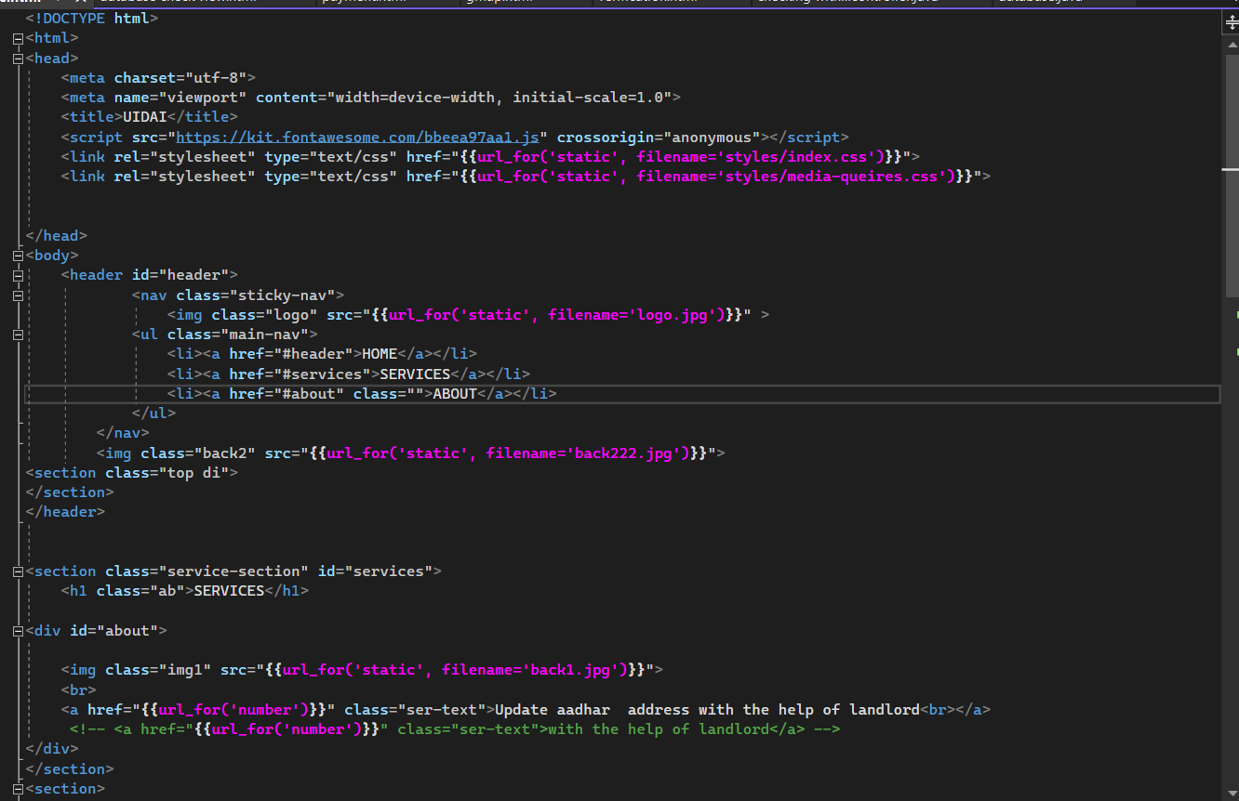
CODE

Slide 5
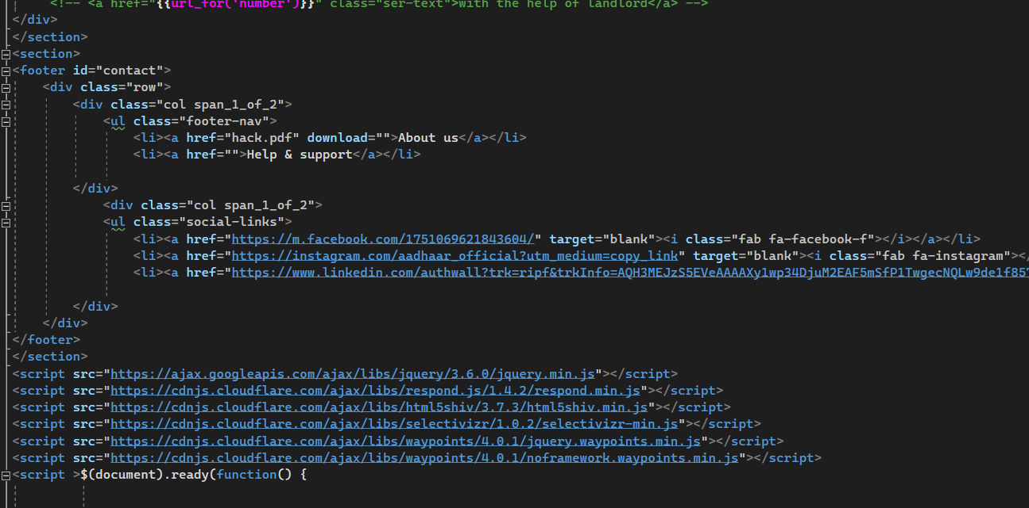

Slide 6
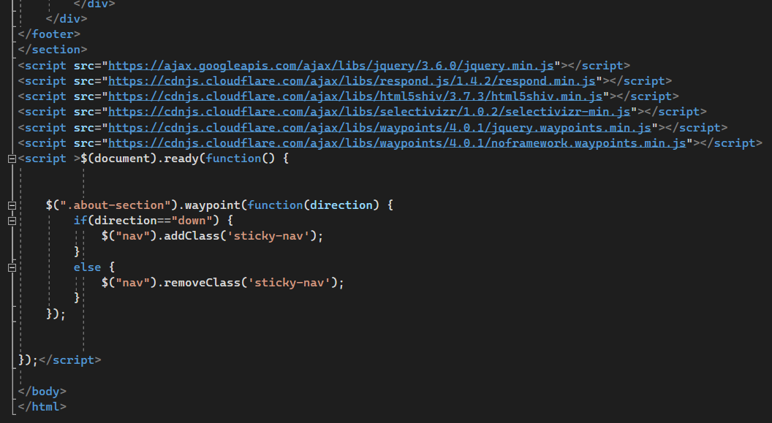

Slide 7
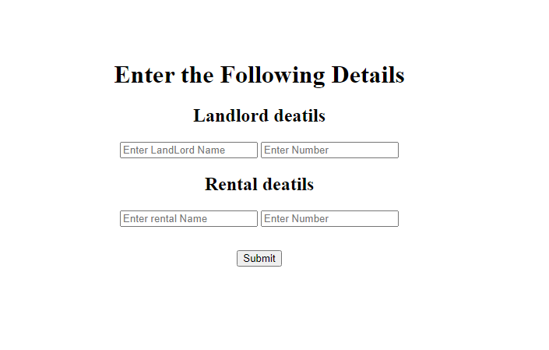
TOPIC ONE
Submitting basic details
They need to enter landlord and rental names
Landlord and rental registered mobile numbers

Slide 8
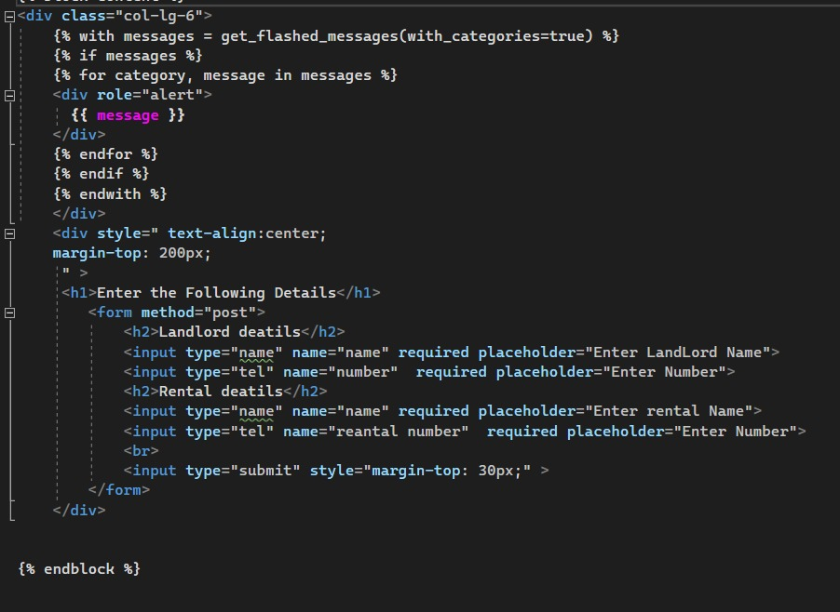
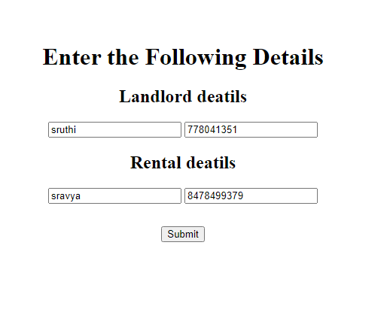
CODE , FLOW OF EXECUTION

Slide 9
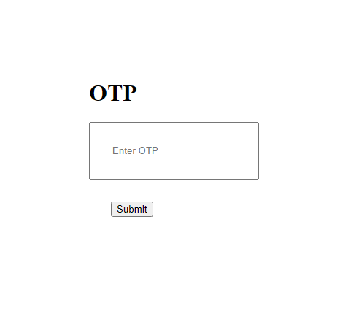
TOPIC TWO
OTP VERIFICATION
After submitting basic details , an OTP will be sent.
OTP will be sent to landlord.
He need to verify his details , submit his OTP

Slide 10
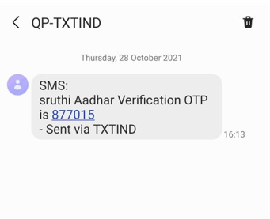
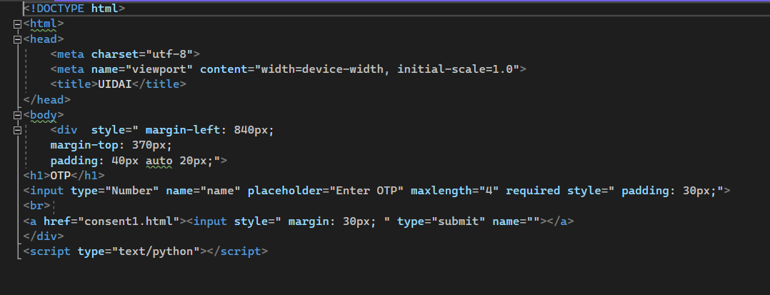
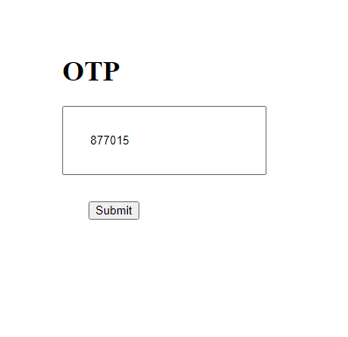

Slide 11
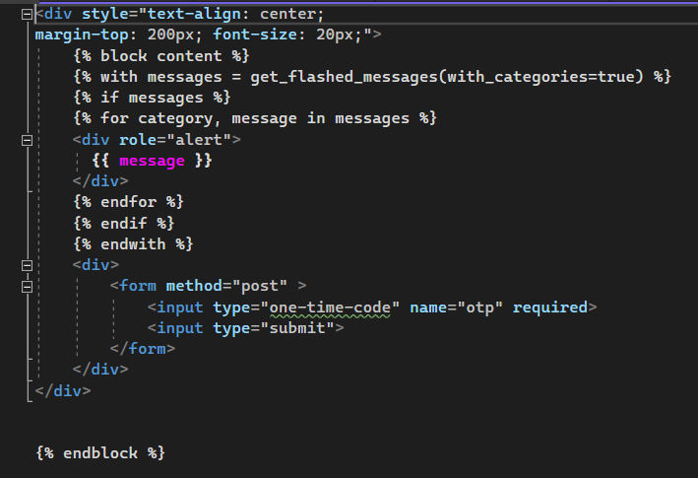

Slide 12
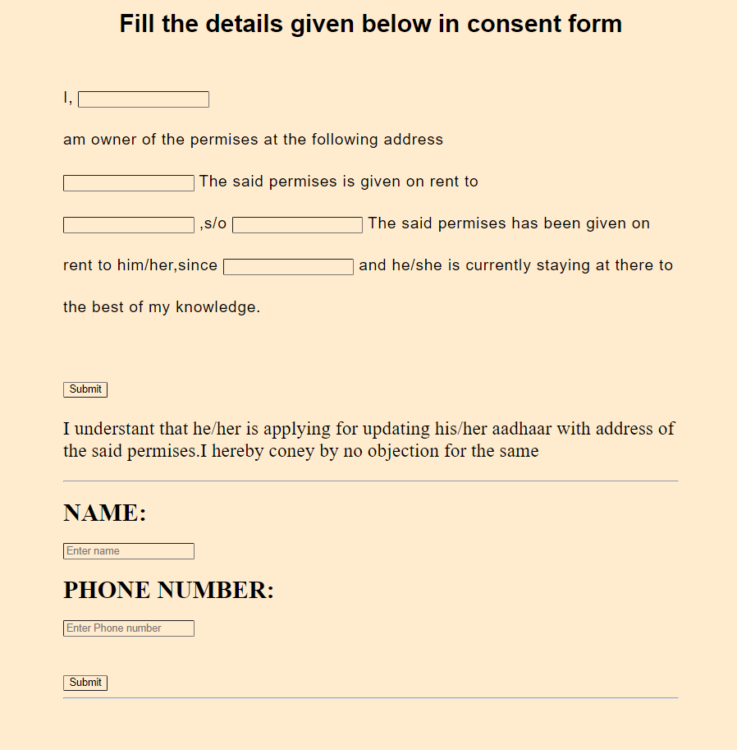
TOPIC THREE
Providing consent form
Landord have to fill the given details in the CONSENT FORM.
Then he need to click on SUBMIT after crosschecking his/her details.
He need to enter his/her NAME , PHONE NUMBER.

Slide 13
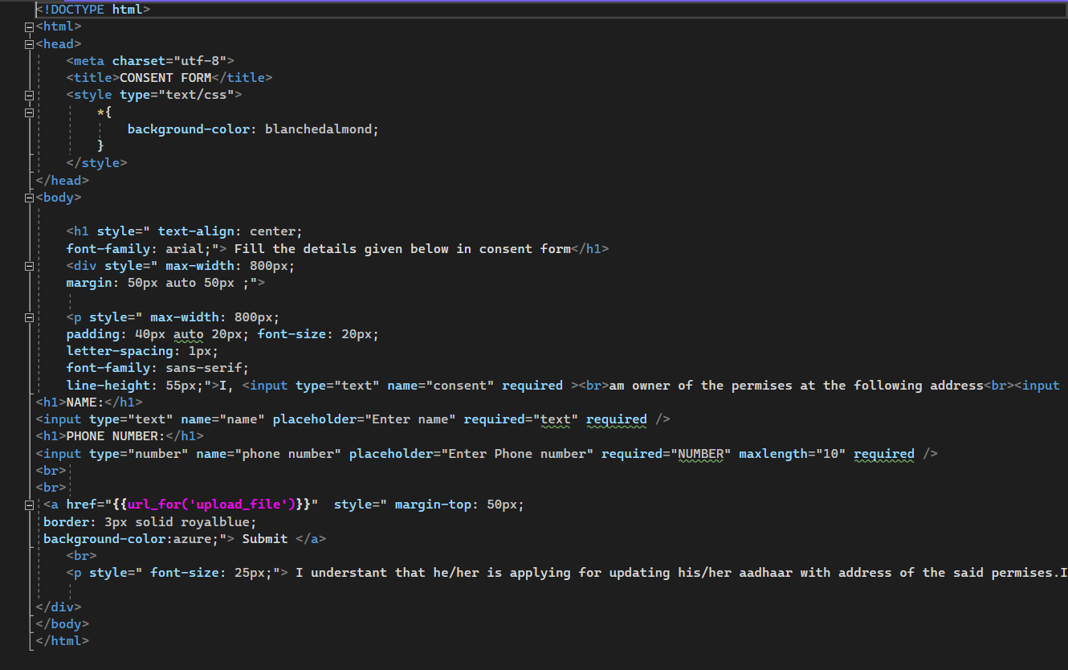
CODE

Slide 14
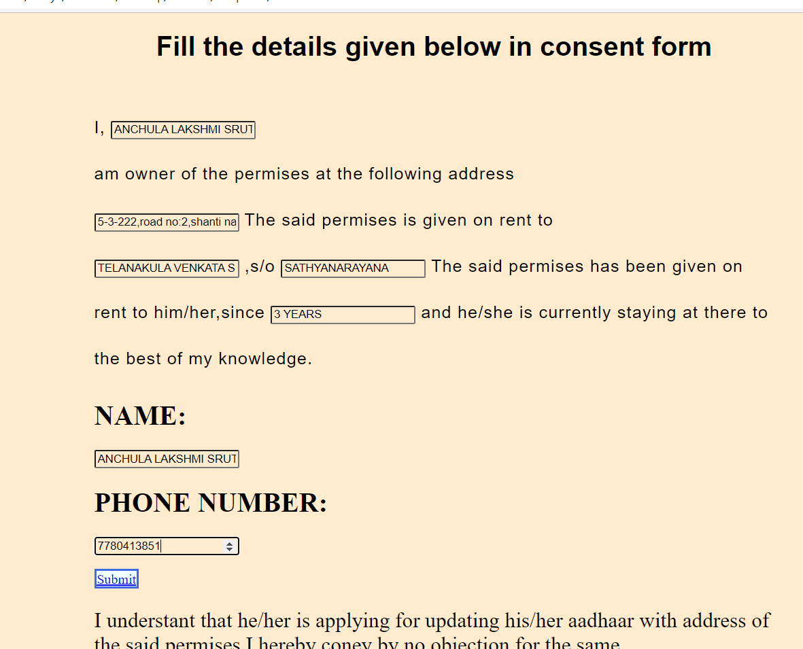
FLOW OF EXECUTION

Slide 15

TOPIC FOUR
E-KYC OPTION
After submitting CONSENT FORM , He need to SUBMIT proper documents (ADDRESS PROOFS)
Address proofs consist of [driving license , pan card , passport , voter id..etc].
He/she need to submit their documents by scanning it.
They need to SUBMIT them digitally.

Slide 16
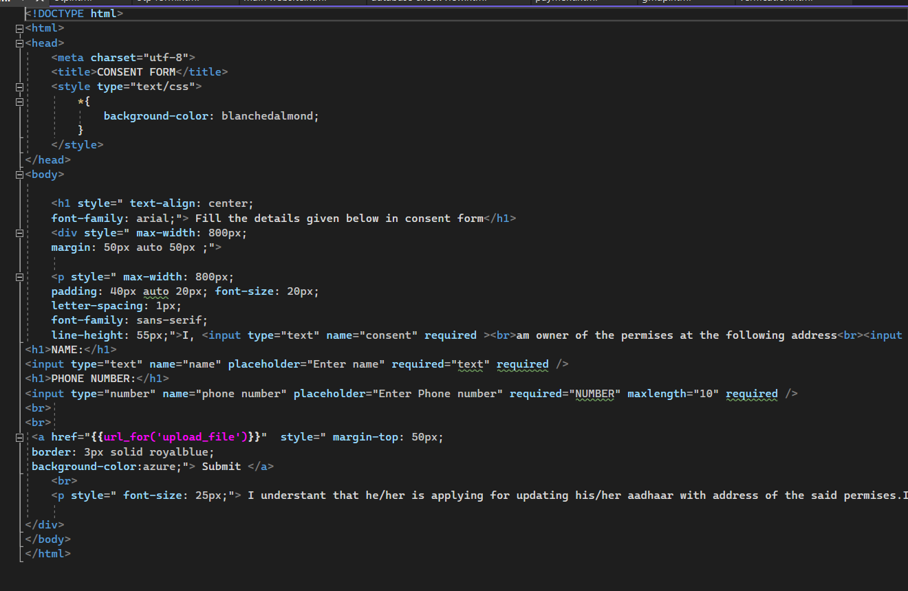
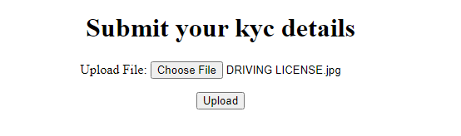
CODE AND FLOW OF EXECUTION

Slide 17
TOPIC FIVE
ADDRESS VERIFICATION
Address proof given by landlord will be checked by the database using API’s.
If the address proof doesn’t match with our database , the webpage will be terminated.
If YES , rental will be accessed for further procedures to update his details.

Slide 18
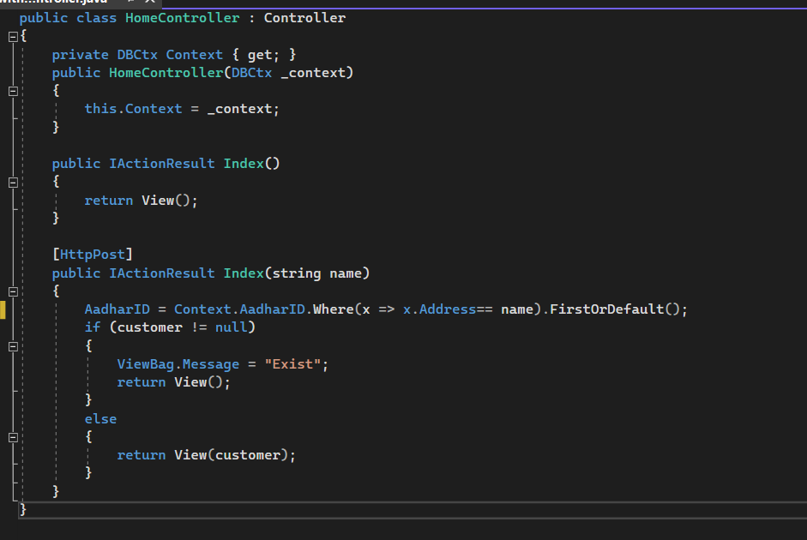
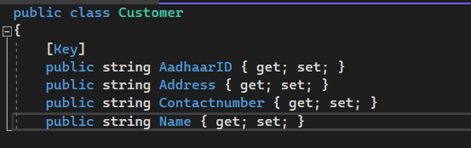
CODE AND FLOW OF EXECUTION

Slide 19
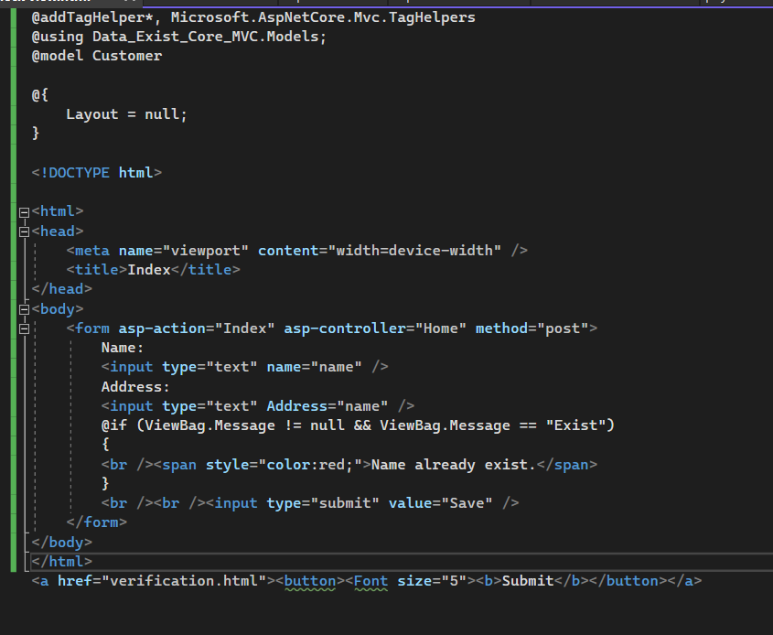
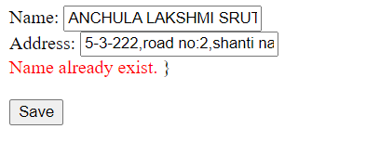

Slide 20
TOPIC SIX
GPS TRACKING
IF RENTAL have any minor changes , then he need to change his address.
After changing ,using GPS tracking software the rental will be tracked .
If rental lives in correct place , rental’s request will be GRANTED for changing address.
If NO , permission will be DENIED.
PAYMENT page is opned.

Slide 21
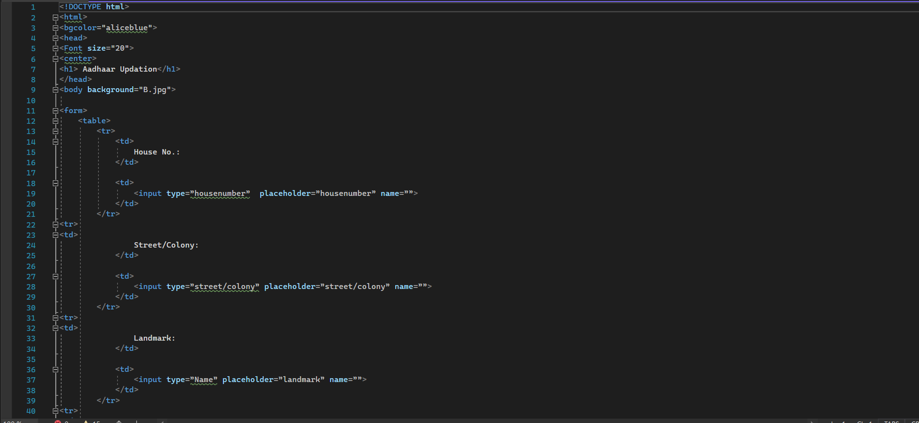
CODE

Slide 22
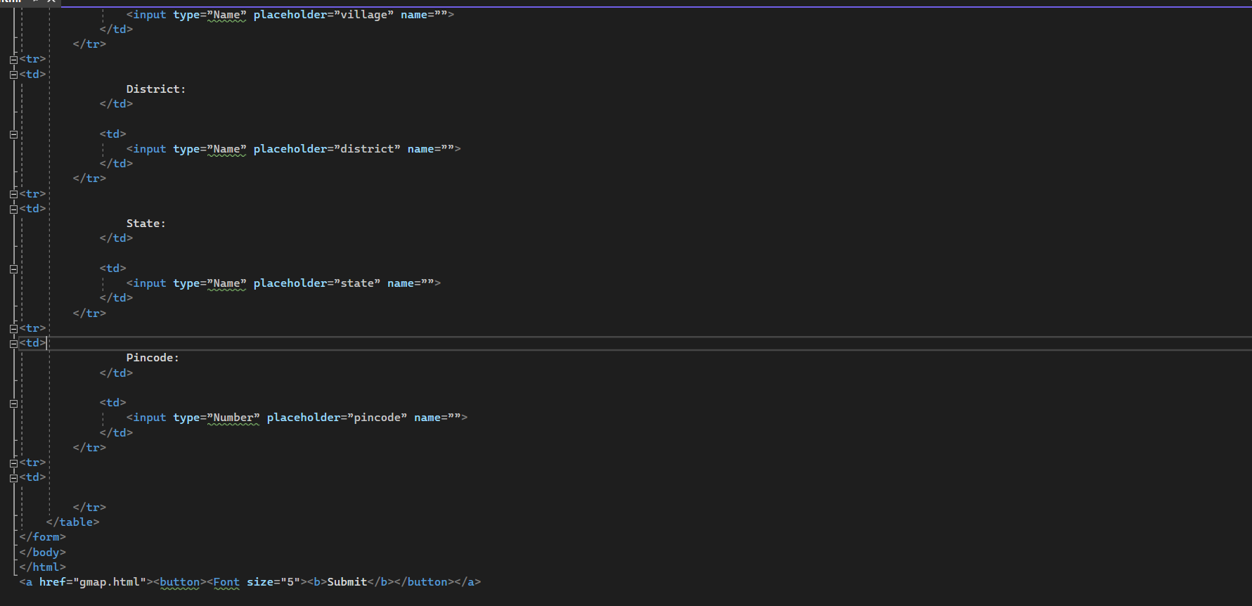
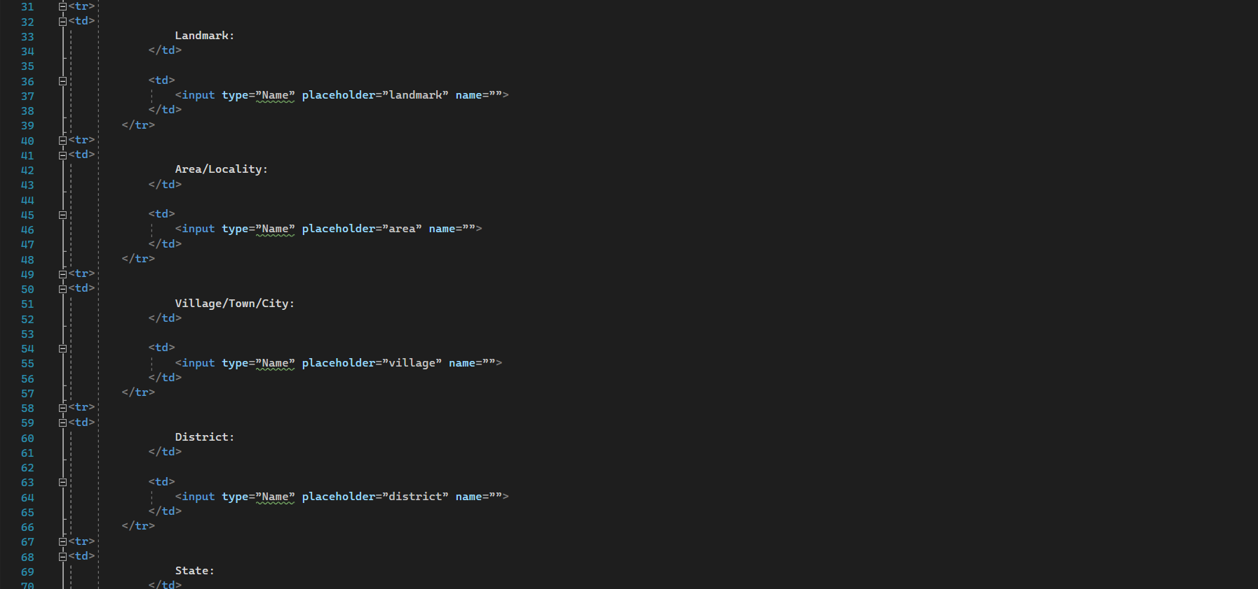
CODE

Slide 23
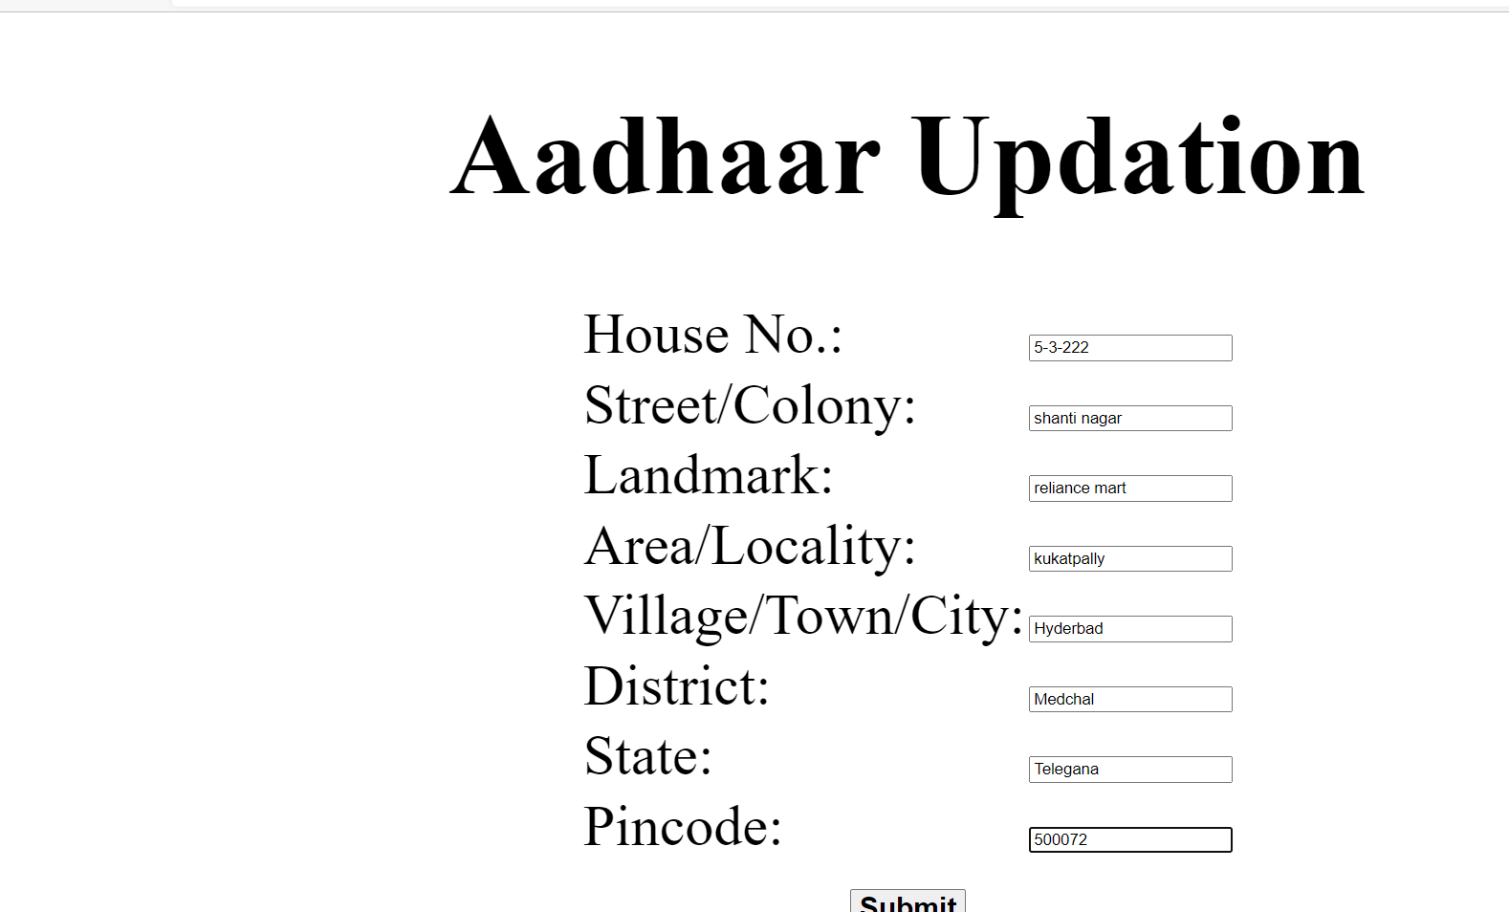
FLOW OF EXECUTION

Slide 24
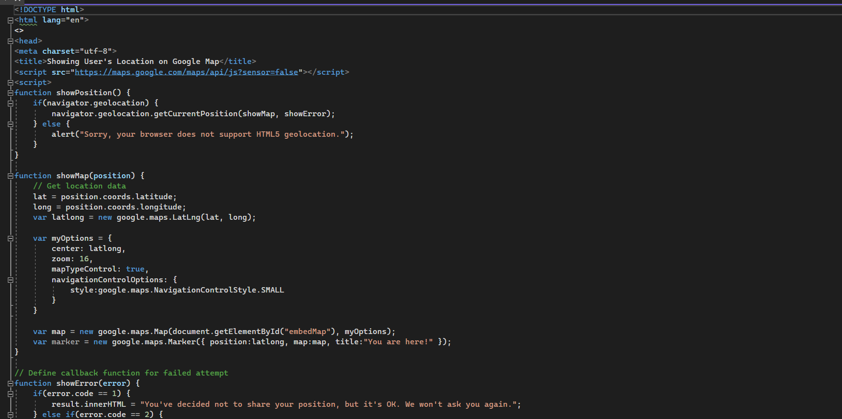
CODE (GPS)

Slide 25
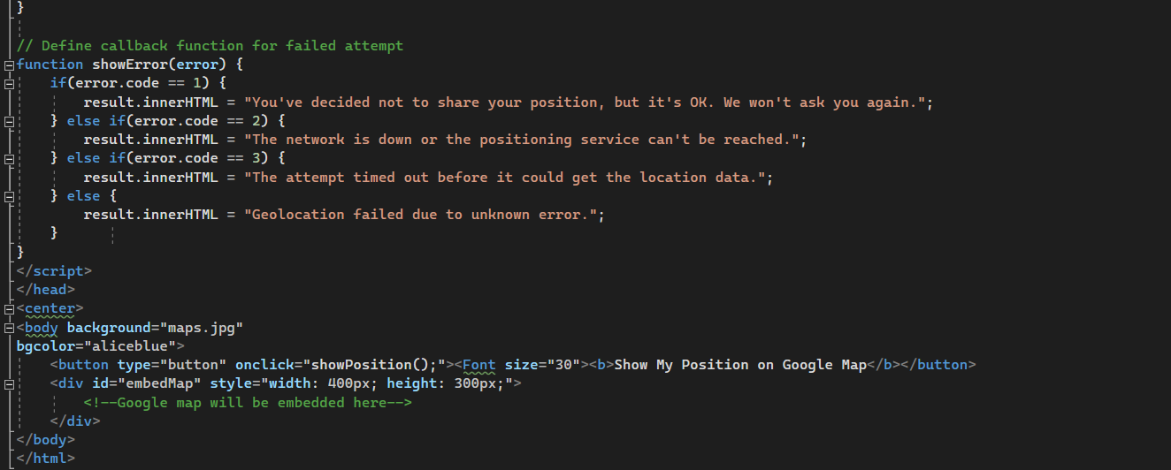

Slide 26
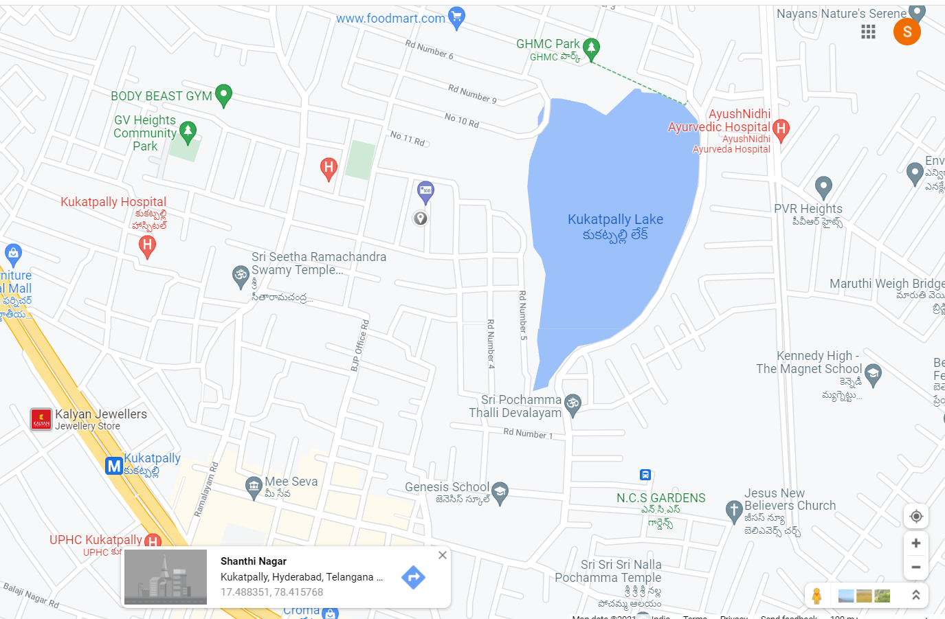
FLOW OF EXECUTION

Slide 27
Summary
Firstly tenant has to submit his name along with his landlord name and also the mobile number . Then after submitting that , the landlord gets the link and an OTP
Then landlord enters through the link and submits his given OTP in the given time.
Then the page will be redirected and opens up with a consent form. He has to submit that and also has to submit some address proofs using e-KYC.
After crosschecking , if details are true to his belief then tenant can change his address.
The page will be terminated and tenant cannot change his address only if below details are missing
1)if wrong OTP being entered.
2)if address proof doesn’t match.
3)if landlord doesn’t accept consent form.
If tenant want to change his address , then using gps tracking software , tenant’s address will be checked .
If it’s true , then tenant can change his address
​

Slide 28

THANK YOU
MLR institute of technolongy

